Slide 1
工作汇报
2023.10.26

Slide 2
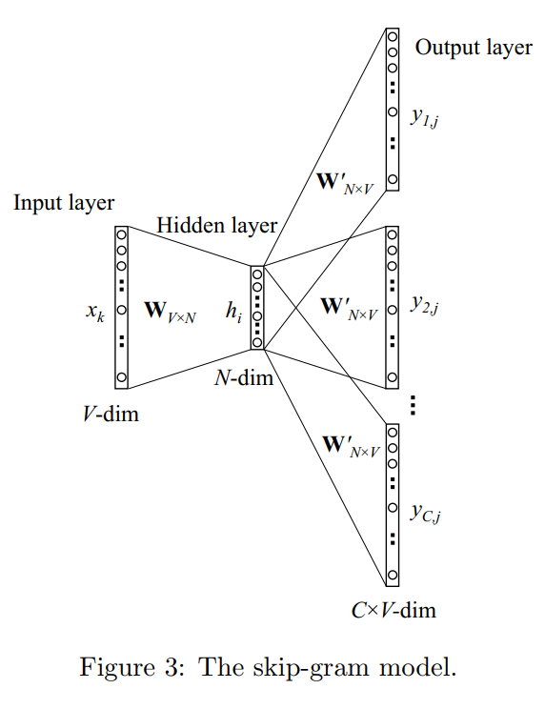
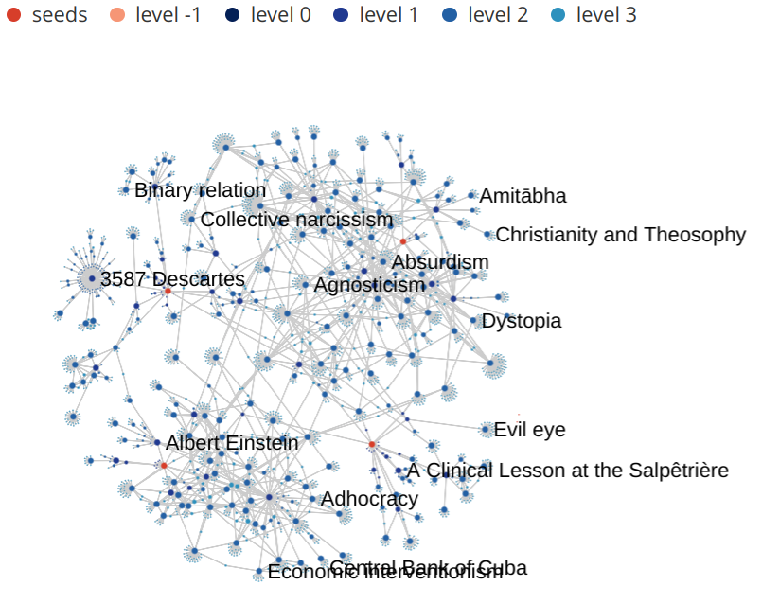
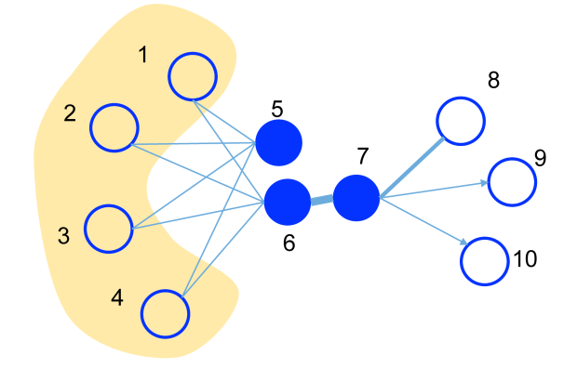
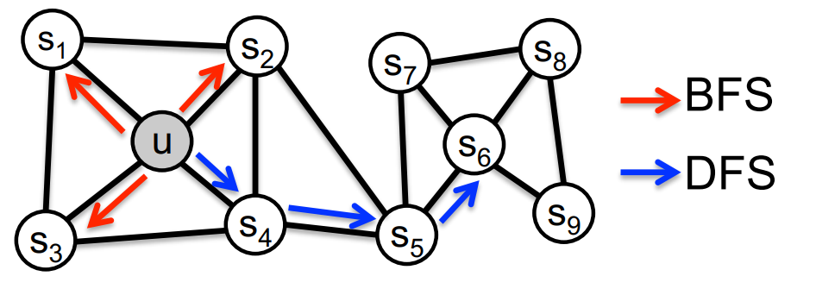
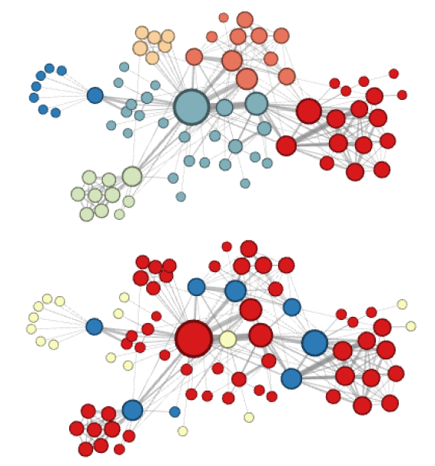
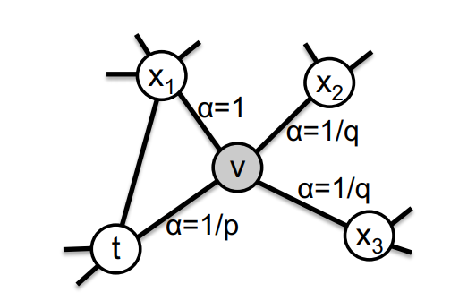
word2vec: (word embedding)
[Efficient Estimation of Word Representations in Vector Space]
[Distributed Representations of Words and Phrases and their Compositionality]
[word2vec Parameter Learning Explained]
walks: (graph embedding)
[DeepWalk: Online Learning of Social Representations]
[LINE: Large-scale Information Network Embedding]
[node2vec: Scalable Feature Learning for Networks]
graph neural networks:
Node Classification and Message Passing
Spectral Graph Theory
[GCN: Semi-supervised classification with graph convolutional networks]

Slide 3
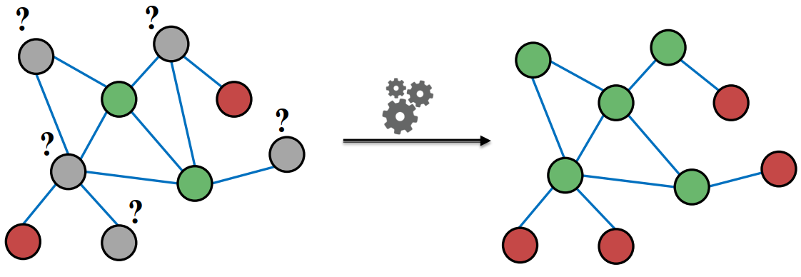
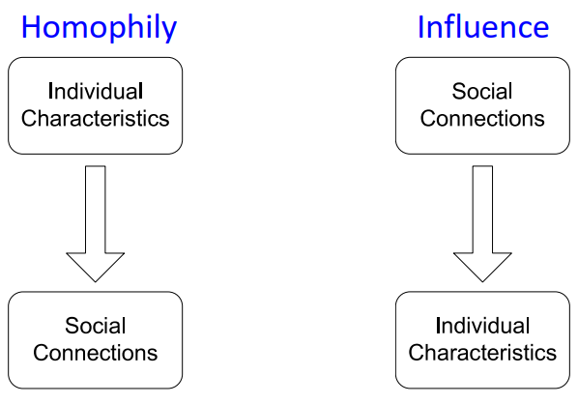
Node Classification and Message Passing
graph embedding
all nodes’ feature
semi-supervised training
classifier
semi-supervised node classification
classification
all nodes’ label
local attributes
neighbourhoods’ attributes
neighbourhoods’ label
local label
1、structural features (not include node attributes)
2、indirectly exploit graph topology information
correlations

Slide 4






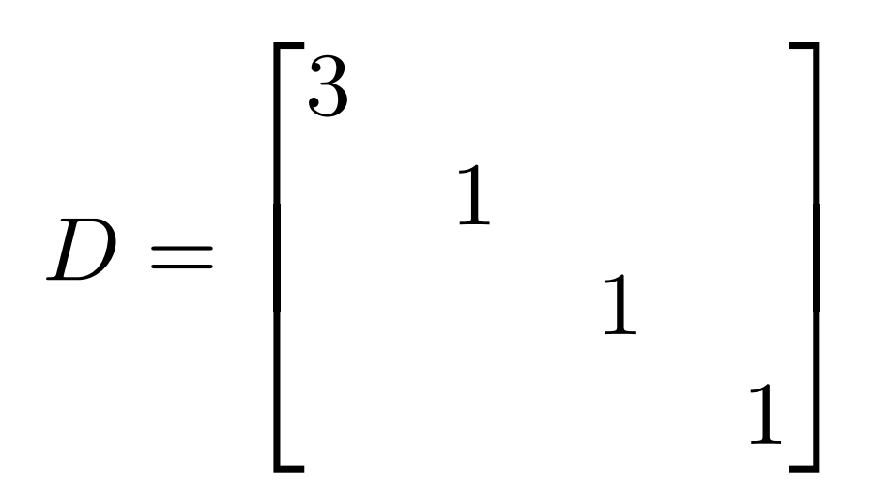


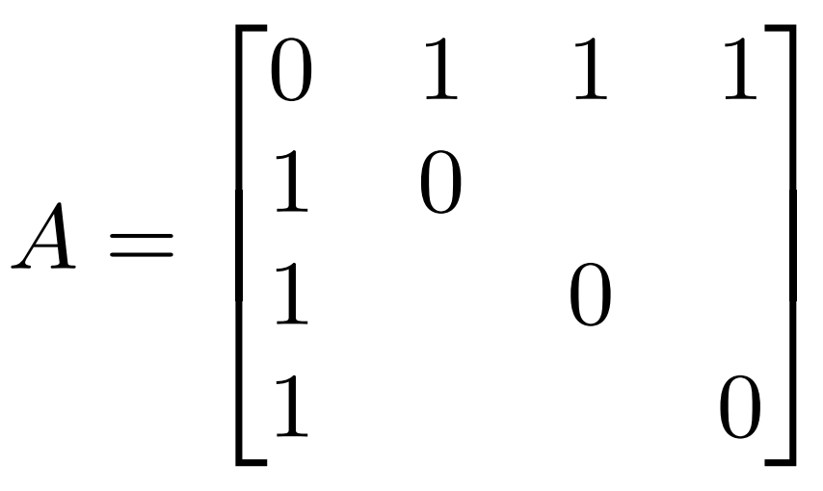


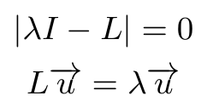


Spectral Graph Theory
v2/s2
e1
v3/s3
v1/s1
谱
e2
e3
v4/s4
幅
频
能量
图
频

Slide 5






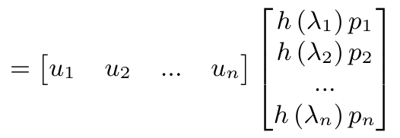








s2
s2’
s3
s3’
s1
s1’
s4
s4’

Slide 6
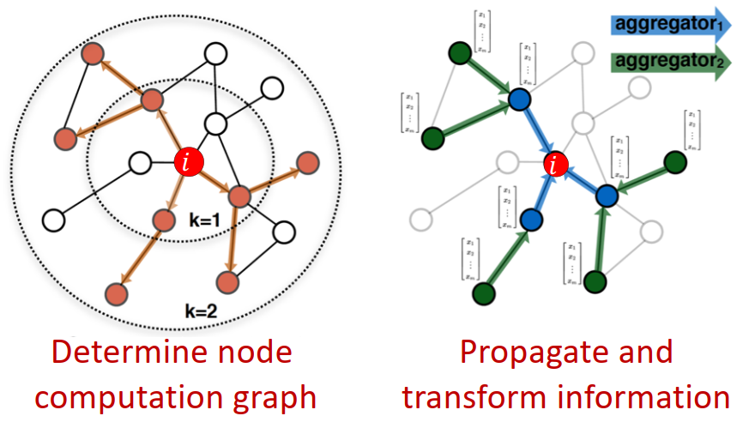
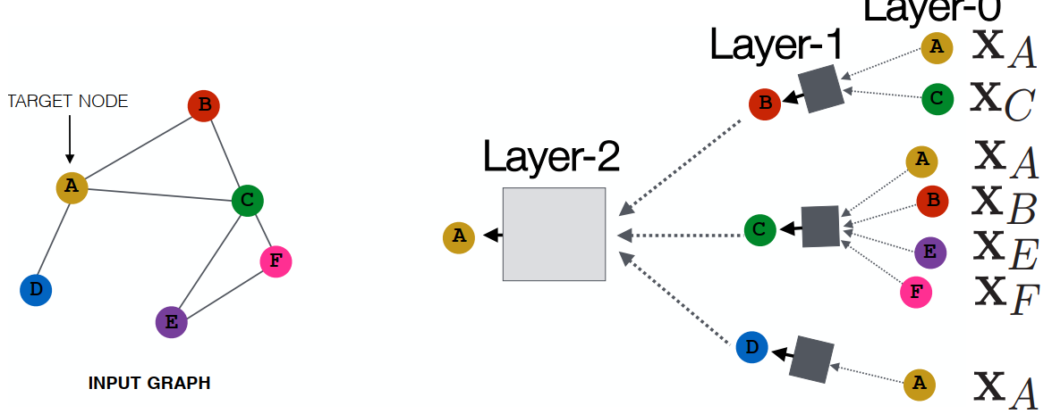
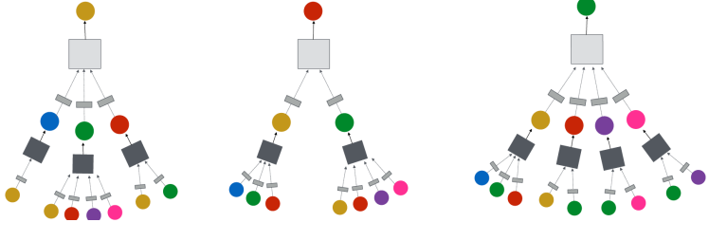
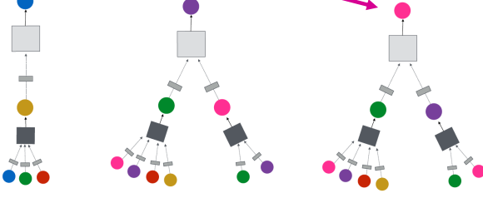
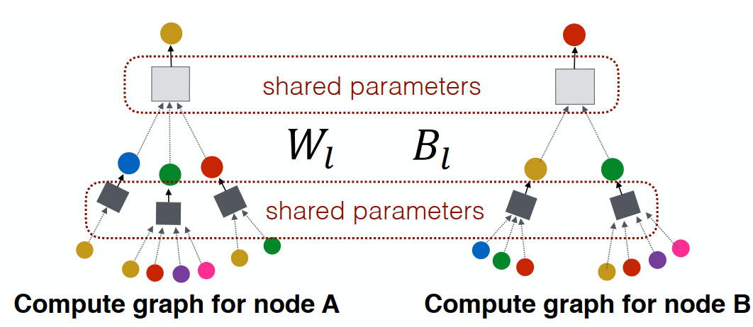
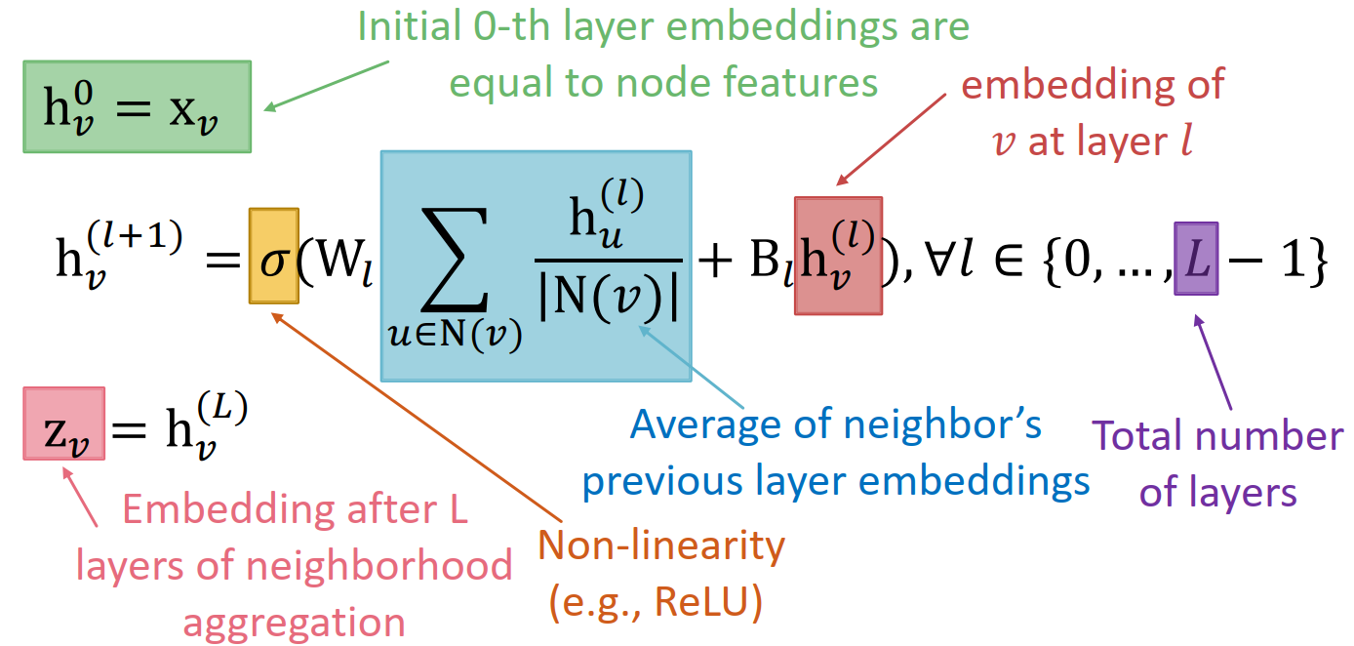


GCN: Semi-supervised classification with graph convolutional networks

Slide 7
